Slide 1

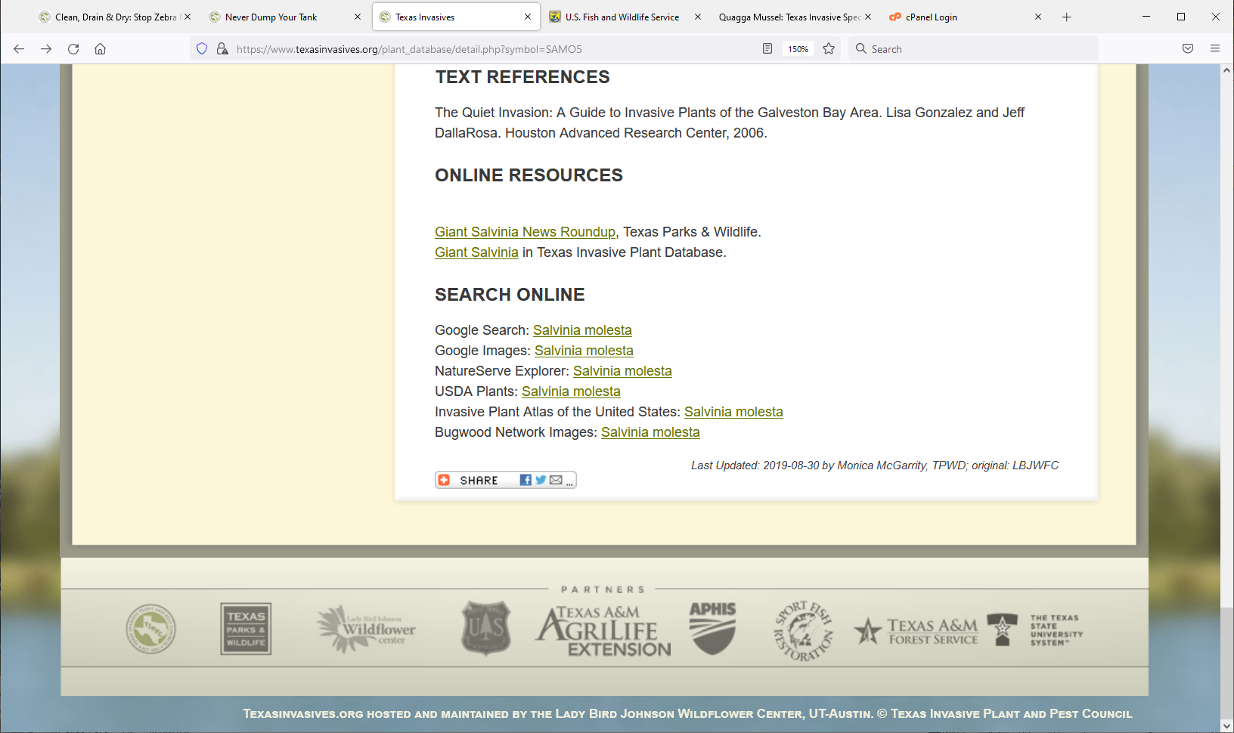
Priority Pest Identification & Transmission Pathways
USDA-APHIS
Texas Invasive Species Institute (TISI)
SHSU Agriculture Sciences
SHSU Engineering Technology

Slide 2
TEKS / OBJECTIVES
TEKS: 130.25 16 (A-B) 17 (A-D) The student identifies how plants grow and how specialized cells, tissues, and organs develop. The student diagrams the structure and function of nucleic acids in the mechanism of genetics.
Objectives:
Student will interpret the transmission pathways and criticize the implications.
Students will construct a plan for the best practices to go over the transmissions.

Slide 3

Anticipation Questions
What are some examples of successful human mitigation efforts?
What could you do when you identify Invasive Species in your community?
What is the best practice in your opinion when handling invasive species?

Slide 4

and Invasive Species Management
Plant Pest and Disease Prevention Program
Enhancing plant pest and disease analysis and survey.
Targeting domestic inspection activities at vulnerable points for safeguarding.
Enhancing and strengthening pest identification and technology.
Safeguarding nursery production.
Conducting targeted outreach and education.
Enhancing mitigation and rapid response capabilities.
Notes:
Six Strategies of the Plant Pest and Disease Management and Disaster Prevention Program
Funds projects and Organizes specific goals for critical needs to strengthen, prevent, detect, and mitigate invasive pests and diseases.
This lesson will focus on transmission pathways and HOW WE CAN MITIGATE
https://www.aphis.usda.gov/aphis/ourfocus/planthealth/ppa-ppdmdpp/ppdmdpp/plant-pest-disease-managemet-disaster-prevention-program

Slide 5


What is a Pathway?
Pathways for invasive species can range depending on how they are spread.
Aquatic vs. Terrestrial
Ex: Zebra Mussel vs. King Ranch bluestem
Intentional vs. Accidental
Ornamental plant vs. Seed contaminants
Humans have imported and transplanted numerous species throughout the world.
Notes:
Photos are hyperlinked to their websites: Stop Aquatic Hitchhikers and USDA-APHIS website. Students can go there to learn more!

Slide 6
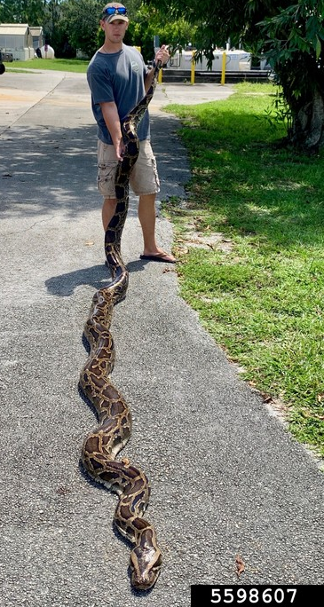
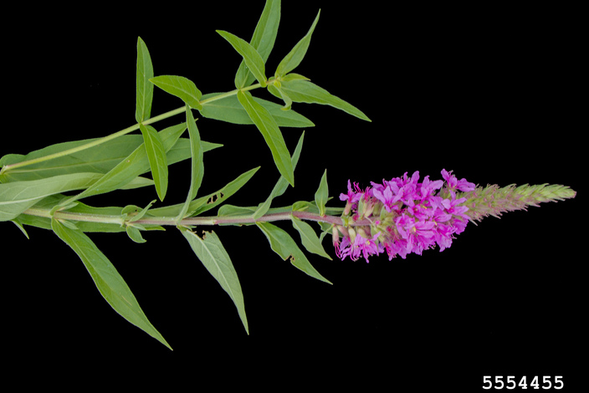

What is a Pathway?
Pathways are created by human interactions more often than natural dispersal.
Escape (from field, greenhouse, aquarium, etc.)
Pet Trade
Ornamental / Aesthetic Purpose
Imported Goods
Many species are “Hitchhikers” on imported goods and shipping supplies.
Brought to manage or replace other species
Notes:
Python: Robert Edman, Florida Fish and Wildlife Conservation Commission , Bugwood.org
HUGE problem in Florida, all from people dumping their pythons “into the wild” AKA the Florida Everglades.
Purple Loosestrife: David Cappaert, Bugwood.org First introduced in the 1800's to the United States, purple loosestrife was intended for medicinal and ornamental uses.

Slide 7
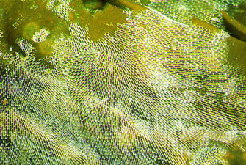
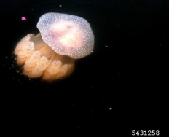
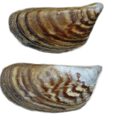
Examples: Aquatic Importation
Importation of goods and how they are transported has led to accidental introduction.
Many invasive aquatic animals have microscopic larvae that are drawn up in the ballast water for cargo ships.​
Invasive Bryozoans
Australian Spotted Jellyfish
Quagga Mussels
Zebra Mussels
Further spread by recreational boating
Spread of Zebra Mussels Animation
Notes:
Students are to interpret the animation and the impact of the transmissions and think of ideas on how to minimize and fix the problem

Slide 8
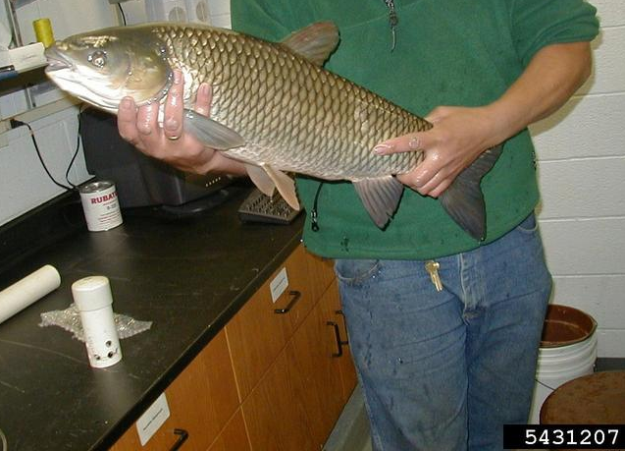
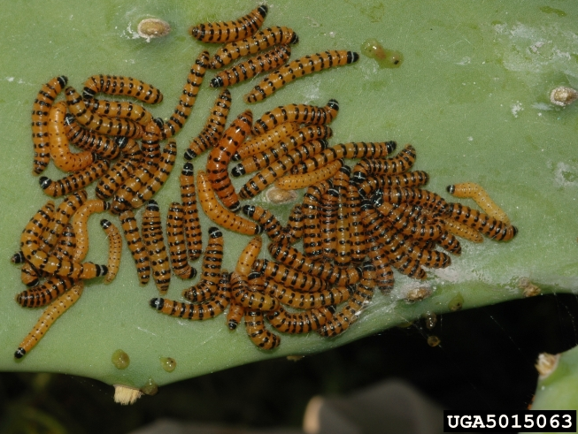
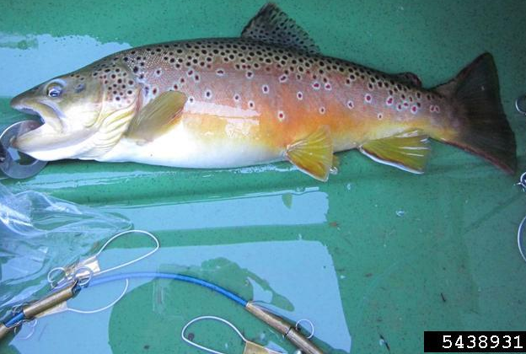
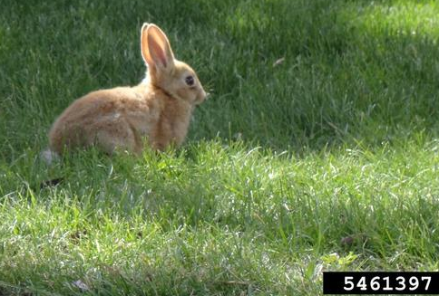
Examples: Biocontrol gone wrong.
Grass Carp- to control invasive aquatic plants like Hydrilla.​
Cactus Moth- In Australia and the Caribbean, imported to control Opuntia cacti.​
European Rabbit- brought to Washington state to control weeds.
Brown Trout- Imported to fill overfished waterways.
Notes:
Grass Carp (Top Right): USGS , US Geological Survey, Bugwood.org
Once imported it did manage Hydrilla BUT it also reproduced faster than native carp species causing major ecosystem shifts. NOW Triploid Carps are released for Hydrilla management, they are sterile so they cannot reproduce and takeover native fishes.
Cactus moth photo: Ignacio Baez, USDA Agricultural Research Service, Bugwood.org
Moths imported to control Opuntia cacti. However, bringing it to the Caribbean then allowed them to expand to the Florida Keys and United States where Opuntia cacti are native, and necessary for our desert ecosystems.
Rabbit: Joseph LaForest, University of Georgia, Bugwood.org
As a foraging generalist the European rabbit was quickly noted to feed on more than just the targeted pest plants and rapidly became established in the United States as well as all other continents in the world with the exception of Antarctica.
Brown Trout (Bottom Left): Lindsey Lewis, U.S. Fish and Wildlife, Bugwood.org
First imported from German hatcheries into the United States in 1883. In 1886, Pennsylvania began stocking the fish in streams where native brook trout populations had been severely decreased by logging, farming and dam construction. STILL USED as a sport fish despite the invasive nature.

Slide 9
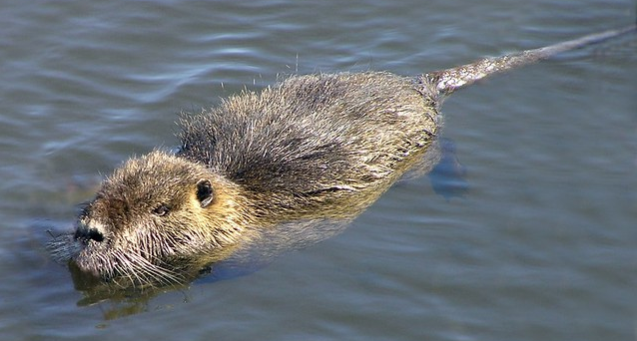
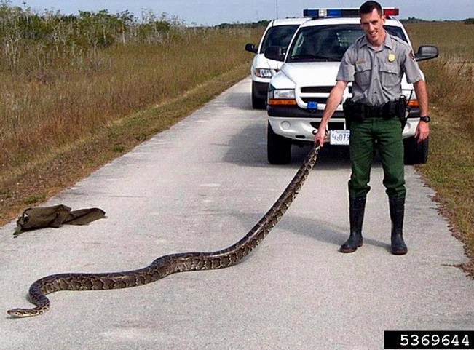
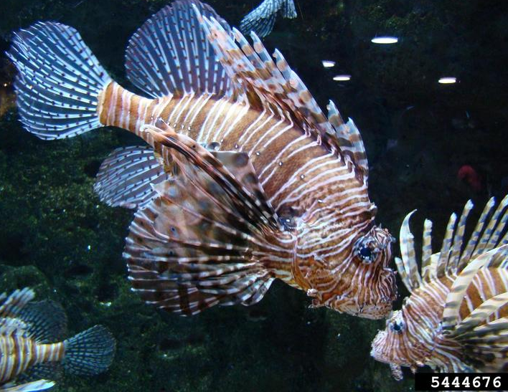
Examples: Animal Trade failures
Nutria- Brought to supplement beaver fur trade and escaped captivity.
Burmese Python- one of the notorious pet-trade invasive species. ​
Red Lionfish- has invaded the Gulf of Mexico up to NC, all from one flooded aquarium in Florida.
Exotic Pet release animation
Notes:
Nutria: Dan Dzurisin, Flickr
Many of the nutria from these ranches were freed into the wild when their businesses failed in the late 1940s. Nutria were also sold as weed cutters to an ignorant public throughout the Southeast. A hurricane in the late 1940s aided dispersal by scattering nutria over wide areas of coastal southwest Louisiana and southeast Texas.
Python: Bob DeGross, National Park Service, Bugwood.org
Since their release, the Burmese pythons have continued to reproduce and become established in the swamps of the everglades. They are known to feed on white-tailed deer and American alligators. Starting in 2013, Florida has hosted the Python Challenge, which recruits citizens to hunts as many pythons as possible. In order to protect the rest of Florida, the South Florida Water Management District is willing to pay people to hunt pythons.
Lionfish: Rebekah D. Wallace, University of Georgia, Bugwood.org
Red Lionfish feed on crustaceans, other invertebrates, and over 40 different species of fish. They forage among coral reefs and are very opportunistic. Red Lionfish are also known to adapt to new prey items quickly, which allows them to infiltrate novel habitats with ease.

Slide 10
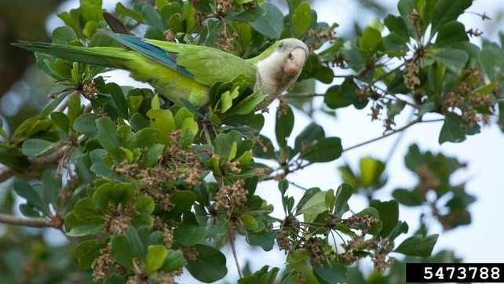
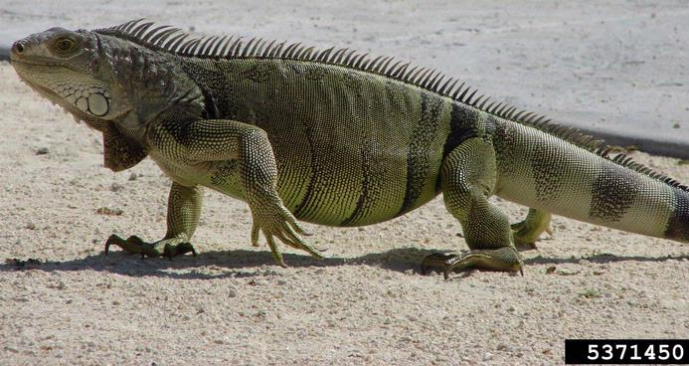
Examples: Animal Trade failures
Monk Parrot- imported in 1960s as exotic pets; 1992 US banned its importation.
Green Iguana- ornery disposition and long lifespan often get them released into the wild. ​Has invaded Puerto Rico, Florida and south Texas. Prohibited species in Florida.
Notes:
Monk parrot: Stephanie Sanchez, Bugwood.org
Escaped accidentally and were released in various parts of the United States. They become established due to their high tolerance for a wide range of temperatures, including extreme cold and hot weather.
Iguana: Vicky Quick, National Biological Information Infrastructure, Bugwood.org
They were first reported outside of captivity in Miami, Florida in 1966 and are now overrunning the Everglades. In Texas, they slowly worked their way up from Southern Mexico to Southern Texas, where they have been established at least since the 1990s. For Puerto Rico iguanas have completely overrun the island and are a major pest.

Slide 11
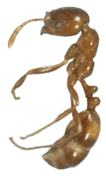
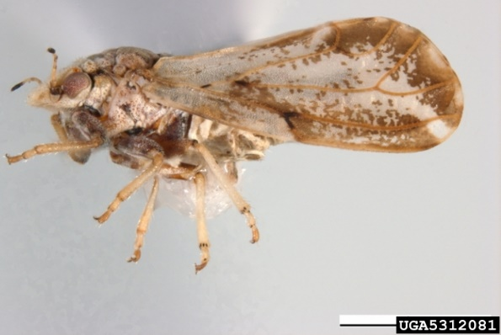
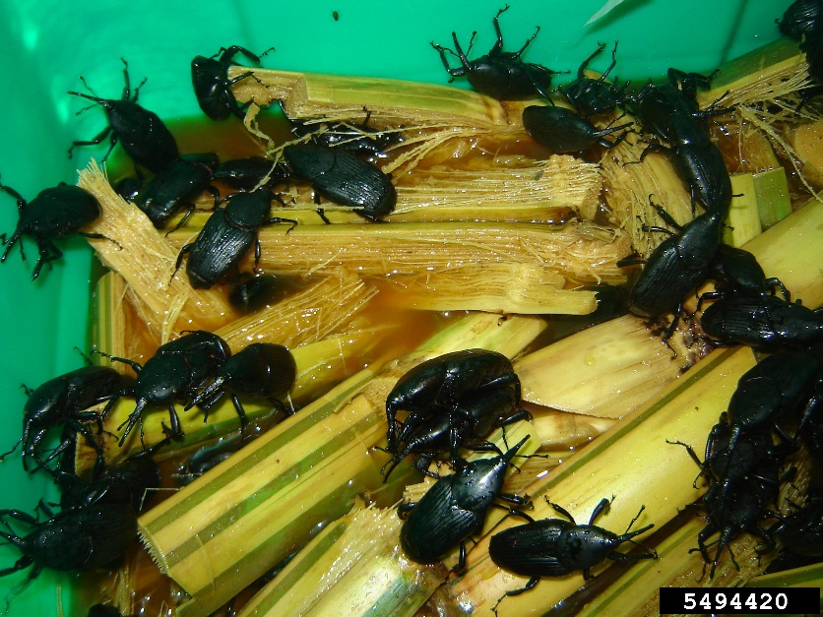
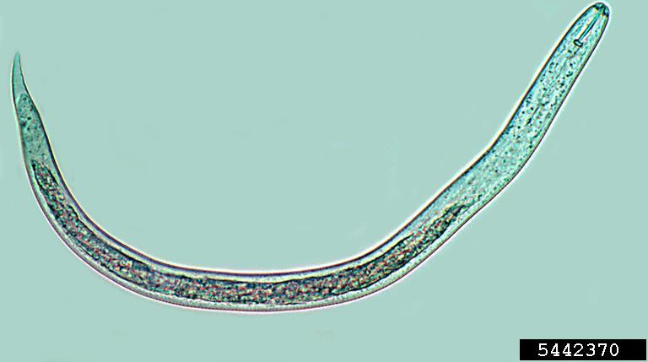
Examples: Terrestrial Importation
Importation of goods and how they are transported has led to accidental introduction of many pests.
Invasive pests often “hitchhike” on other goods being imported like crop root stock, plants, fruits and grains.​
Examples:
Asian Citrus Psyllid
Red Imported Fire Ants
Invasive Slugs & Flatworms
Soil Nematodes
South American Palm Weevil
U.S. Introduction of Fire Ants
Notes:
Click red ribbon for animation

Slide 12
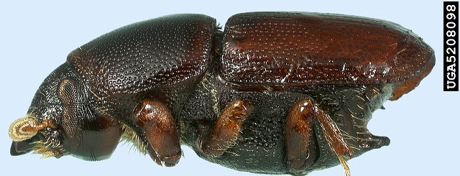
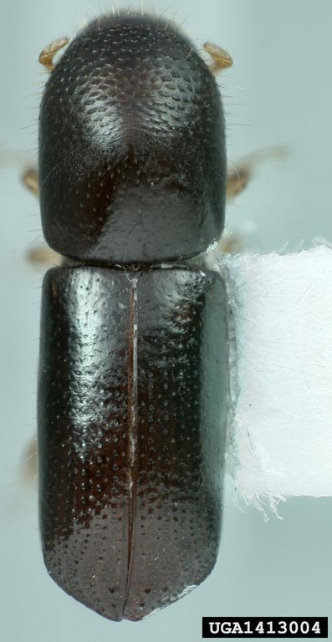
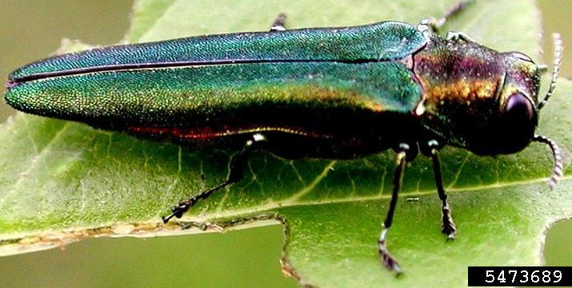
Examples: Terrestrial Importation
Importation of goods and how they are transported has led to accidental introduction of many pests.
Other invasive pests, especially bark beetles, have spread by embedding in wooden pallets, hiding in wooden chips for cargo or as cargo stowaways.
Asian Longhorned Beetle
Emerald Ash Borer
Redbay Ambrosia Beetle
Smaller European Elm Beetle
Then spread by movement of firewood
EAB introduction & spread
Notes:
Click red ribbon for animation

Slide 13
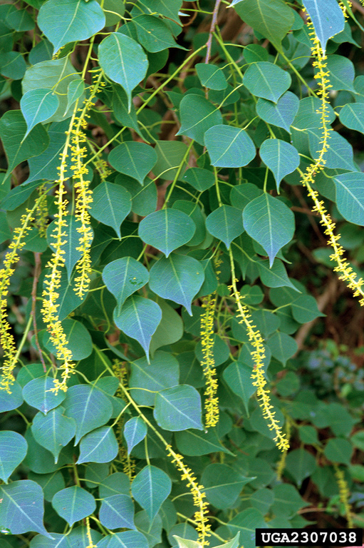
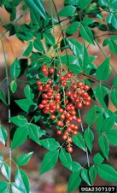
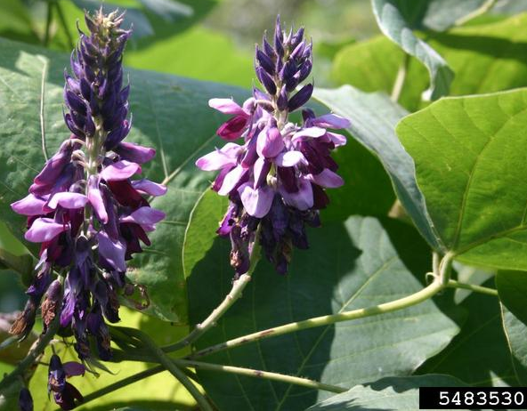
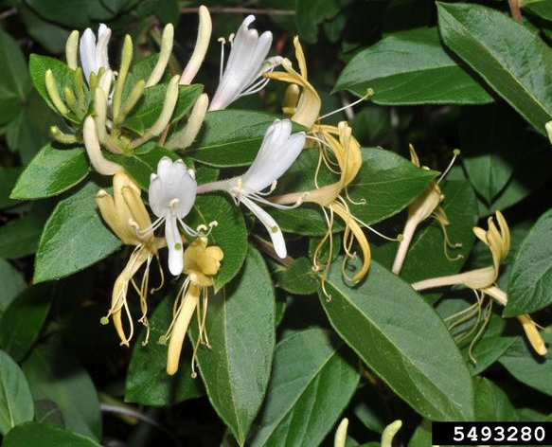
Examples: Imported Plants
Brought for ornamental/aesthetic purposes​
The main pathway hundreds of invasive plant species have entered the US.​
Chinese Tallow​
Nandina​
Kudzu​
Japanese Honeysuckle
Further spread by escaping cultivation
Notes:
Chinese Tallowtree: James H. Miller, USDA Forest Service, Bugwood.org
Brought over by colonists in the 1700s for the tallow seed oil & soap production and pretty leaves.
Nandina: James H. Miller, USDA Forest Service, Bugwood.org
Originally brought to US in late 1800s, for sale in landscaping. Became naturalized by 1903.
Kudzu: Leslie J. Mehrhoff, University of Connecticut, Bugwood.org
Introduced in the United States in the 1800's as an ornamental plant and livestock control.
Honeysuckle: William M. Ciesla, Forest Health Management International, Bugwood.org
Introduced to North America in the early 1800s for sweet and fragrant flowers. Spread from New England to the Ohio Valley, in the 1940s it spread down south to the Atlantic and Gulf coastal plains.

Slide 14
What is a Pathway?
Animation & Lesson recall:
What are the similarities between the spread of mussels, insects, plants, exotic pets and soil nematodes?
What were the pathway differences?
Notes:
Similarities: Tied into humans moving plants and animals around. Whether it is was accidental like Zebra Mussels in ballast water or intention like the Pet Trade, it all boils down to human intervention.
Differences: Zebra mussels arrived in ballast water. Fire Ants hitchhiked in potted plants to then establish in the US. EAB arrived on wooden pallets and spread throughout the US because of moving firewood.

Slide 15
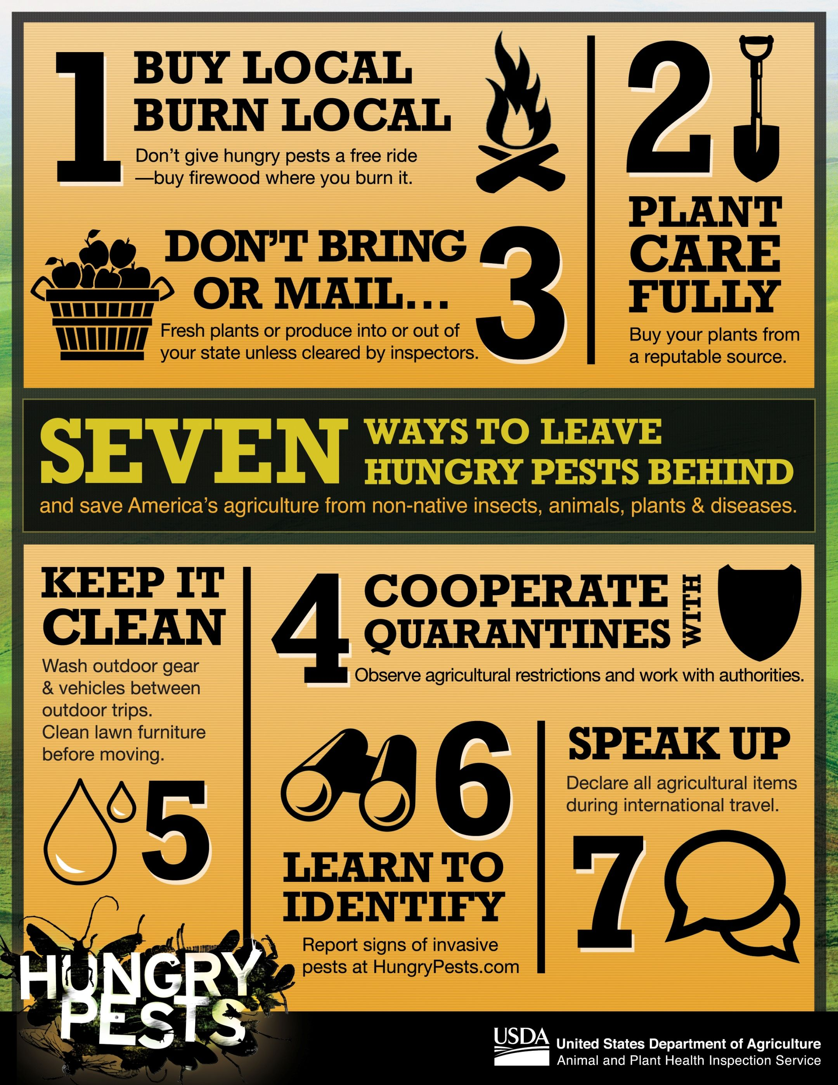



Pathway Prevention
Notes:
Students are to interpret the animation and the impact of the transmissions and think of ideas on how to minimize and fix the problem

Slide 16
Stop the Spread: Elevator Pitch
How would you tell your friends about Invasive Species?
How would you get them to prevent pathways for Invasives?
Pair up and you are given 5 minutes to produce a 1-minute pitch on transmission pathways.
Props must be used.
Both members must speak.

Slide 17


Notes:
Next we’ll discuss how YOU can help prevent the spread of invasives.

